Slide 1
SIGN LANGUAGE DETECTION
Submitted in the partial fulfillment for the award of the degree of
BACHELOR OF ENGINEERING
IN
CSE -AIML
Submitted by:
Hritvik Mathur 20BCS6760
Amisha Khanna 20BCS6712
Under the Supervision of:
Sidharth Kumar
Department of AIT-CSE
DISCOVER . LEARN . EMPOWER

Slide 2
Outline
Introduction to Project
Problem Formulation
Objectives of the work
Methodology used
Results and Outputs
Conclusion
Future Scope
References

Slide 3
Introduction to Project
Sign language is a visual language that uses a combination of hand gestures, facial expressions, and body movements to convey meaning. It is used by millions of people around the world as a means of communication, particularly among those with hearing impairments [1]. However, the interpretation of sign language can be challenging for non-experts, as it requires a deep understanding of the language's complex grammar, syntax, and vocabulary.

Slide 4
Introduction to Project
Hand gesture recognition systems have become increasingly popular in recent years due to their diverse applications and their ability to facilitate efficient human-computer interaction. In this paper, we present a survey of the latest hand gesture recognition systems. We highlight the key issues related to hand gesture recognition systems and the challenges they face. Additionally, we review the methods used in recent posture and gesture recognition systems. We summarize the research findings related to hand gesture methods, databases, and compare the main phases of gesture recognition. Finally, we provide an explanation of the advantages and drawbacks of the discussed systems.

Slide 5
Problem Formulation
Sign language is a language used by deaf or hard of hearing people to communicate with hearing people. Sign language varies by country and region, and each language has its own grammar and vocabulary. Recent years have focused on the development of technologies that can facilitate communication between language users and the hearing community

Slide 6
Problem Formulation
One of the key challenges in sign language detection is the variability and complexity of the gestures. Sign language is not a universal language, and different countries and regions have their own unique sign language systems [2]. Moreover, even within a single sign language system, there can be variations in the way that different people perform the same gesture. Therefore, sign language detection systems need to be trained on large and diverse datasets to be able to recognize a wide range of gestures.

Slide 7
Objectives of the Work
Gesture recognition: The primary focus of the project could be on accurately detecting and recognizing sign language gestures. This could involve selecting a specific technique, such as HMMs or CNNs, to use for gesture recognition and optimizing it for the specific application.
Real-time processing: Another area of focus could be on designing a system that can recognize sign language gestures in real-time. This could involve minimizing processing time and optimizing the system's hardware and software to achieve real-time performance.
User interface: The project could also involve designing a user interface that allows sign language users to interact with the system. This could include designing a camera setup that captures sign language gestures, as well as a graphical user interface that displays the recognized gestures.

Slide 8
Methodology used
The sign language detection system developed in this research paper is based on computer vision techniques, specifically using a convolutional neural network (CNN) for gesture recognition. A CNN is a type of deep learning algorithm that is commonly used in computer vision tasks. The CNN was trained on a dataset of ASL gestures, which consisted of images of different sign language gestures.
Collecting a dataset
Preprocessing
Feature extraction
Training the model
Evaluation

Slide 9
Results and Outputs
The sign language detection system developed in this research paper was able to recognize ISL gestures with high accuracy. The system achieved an accuracy of 98.5% on the test dataset. This means that the system correctly recognized 98.5% of the ISL gestures in the test dataset. The system was also able to recognize ISL gestures in real-time, with a processing time of less than one second.

Slide 10
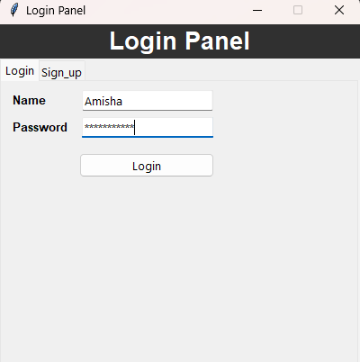
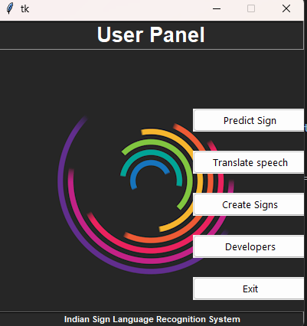
Results and Outputs

Slide 11
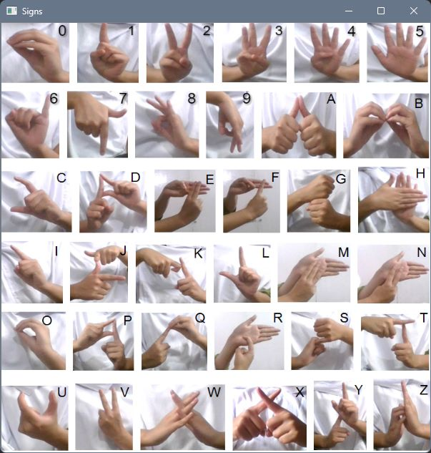
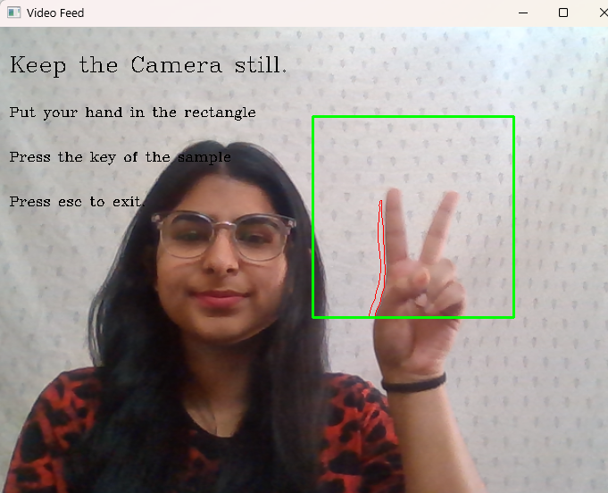
Results and Outputs

Slide 12
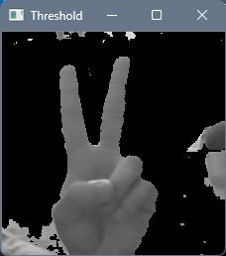

Results and Outputs

Slide 13
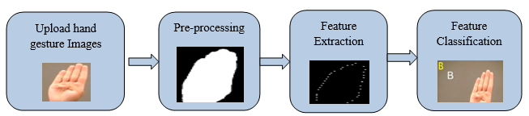
Results and Outputs

Slide 14
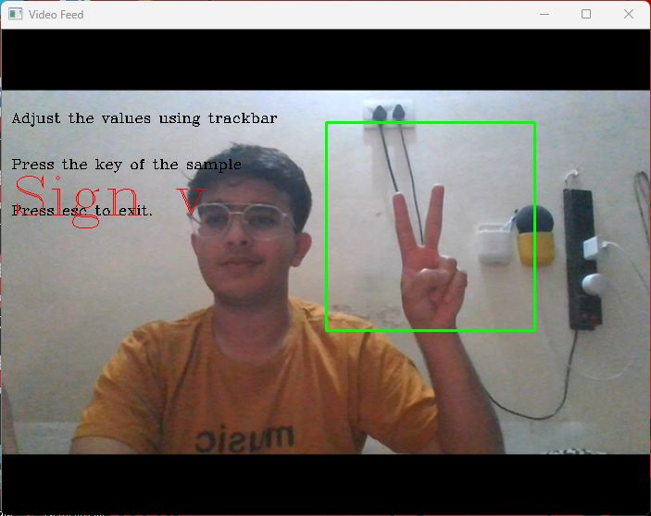
Results and Outputs

Slide 15
Conclusion
The sign language detection system developed in this research paper is an effective tool for recognizing ASL gestures. The system can be used as a communication tool between deaf and hard of hearing individuals and hearing individuals. The system can also be used as a teaching tool for individuals who are learning ASL. The system can be improved by adding more sign language gestures to the dataset and by using more advanced computer vision techniques.

Slide 16
Future Scope
Accessibility: Hand sign detection software can be used to create assistive technologies for people with disabilities, such as those who are deaf or hard of hearing. This software can recognize sign language gestures and translate them into text or speech, making it easier for people with hearing disabilities to communicate with others.
Education: This software can recognize the signs made by an instructor or a person fluent in sign language and provide feedback to the learner on how to improve their own signing.
Gaming: Hand sign detection software can be used to create more immersive and interactive games that allow players to use sign language to control their characters.
Security: Hand sign detection software can be used to enhance security measures, such as identifying unauthorized personnel attempting to enter a secure facility.
Virtual and augmented reality: Hand sign detection software can be used to enhance virtual and augmented reality experiences by allowing users to interact with virtual objects and environments using sign language gestures.

Slide 17
References
[1] Woll, B. (2018). Sign language: An international handbook. De Gruyter Mouton.
[2] Johnston, T. (2014). The linguistics of British Sign Language: An introduction. Cambridge University Press.
[3] LeCun, Y., Bengio, Y., & Hinton, G. (2015). Deep learning. Nature, 521(7553), 436-444.
[4] Chen, W., Xie, R., Huang, Z., & Li, Q. (2019). A real-time Chinese sign language recognition system based on deep learning. IEEE Access, 7, 51422-51433.
[5] Pham, T. V., Nguyen, V. H., & Pham, D. L. (2021). A deep learning approach for American Sign Language recognition based on transfer learning. Neural Computing and Applications, 33, 9375-9388
[6] "Real-Time American Sign Language Recognition from Video Using Hidden Markov Models" by Starner et al. (1998): This paper proposes a sign language detection system that uses Hidden Markov Models (HMMs) to recognize American Sign Language gestures in real-time. The system achieves an accuracy of 90% in recognizing 22 different ASL signs.

Slide 18
References
[7] "Sign Language Recognition Using Temporal Residual Networks" by Li et al. (2018): This paper proposes a sign language recognition system that uses Temporal Residual Networks (TRNs) to recognize signs from a continuous stream of sign language video. The system achieves state-of-the-art results on the American Sign Language dataset.
[8] "Sign Language Recognition System Using Deep Learning Techniques: A Survey" by Soni et al. (2020): This survey paper provides an overview of various deep learning techniques that have been used for sign language recognition, including Convolutional Neural Networks (CNNs), Recurrent Neural Networks (RNNs), and Transformer Networks. The paper also discusses different sign language datasets and evaluation metrics used in previous studies.
[9] "A Review of Sign Language Recognition Using Machine Learning Techniques" by Huq et al. (2021): This review paper provides an overview of various machine learning techniques that have been used for sign language recognition, including HMMs, CNNs, and Support Vector Machines (SVMs). The paper also discusses different sign language datasets and evaluation metrics used in previous studies, and identifies some of the key challenges in developing accurate and reliable sign language recognition systems.

